Slide 1
HTML

Slide 2
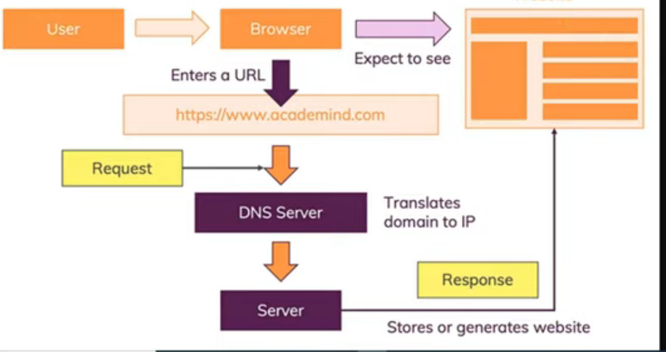

Slide 3
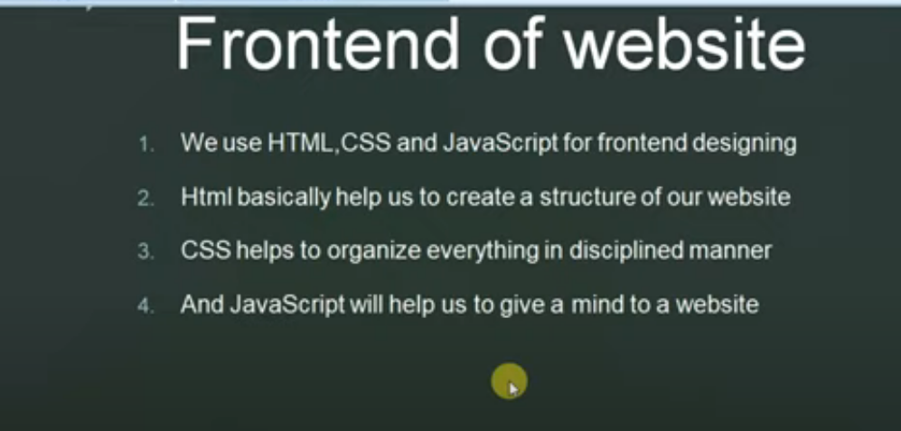

Slide 4
What is HTML?
HTML stands for Hyper Text Markup Language
HTML is the standard markup language for creating Web pages
HTML describes the structure of a Web page
HTML consists of a series of elements
HTML elements tell the browser how to display the content
HTML elements label pieces of content such as "this is a heading", "this is a paragraph", "this is a link", etc.

Slide 5
Simple html document
<!DOCTYPE html> <html> <head> <title>Page Title</title> </head> <body> <h1>My First Heading</h1> <p>My first paragraph.</p> </body> </html>

Slide 6
The <!DOCTYPE html> declaration defines that this document is an HTML5 document
The <html> element is the root element of an HTML page
The <head> element contains meta information about the HTML page
The <title> element specifies a title for the HTML page (which is shown in the browser's title bar or in the page's tab)
The <body> element defines the document's body, and is a container for all the visible contents, such as headings, paragraphs, images, hyperlinks, tables, lists, etc.
The <h1> element defines a large heading
The <p> element defines a paragraph

Slide 7
What is an HTML Element?
An HTML element is defined by a start tag, some content, and an end tag:
<tagname> Content goes here... </tagname>
The HTML element is everything from the start tag to the end tag:
<h1>My First Heading</h1>
<p>My first paragraph.</p>

Slide 8
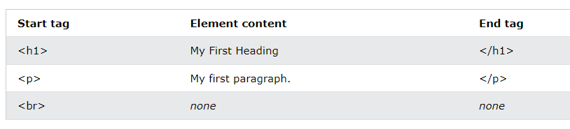
Note: Some HTML elements have no content (like the <br> element). These elements are called empty elements. Empty elements do not have an end tag!

Slide 9
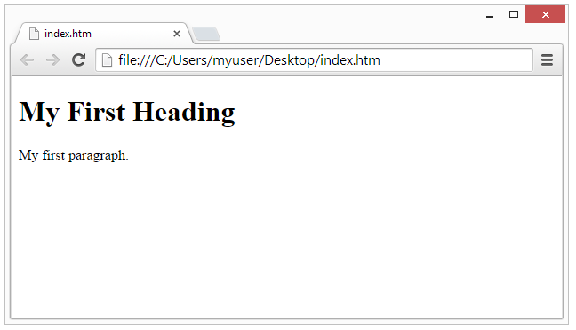
Web Browsers
The purpose of a web browser (Chrome, Edge, Firefox, Safari) is to read HTML documents and display them correctly.
A browser does not display the HTML tags, but uses them to determine how to display the document:

Slide 10
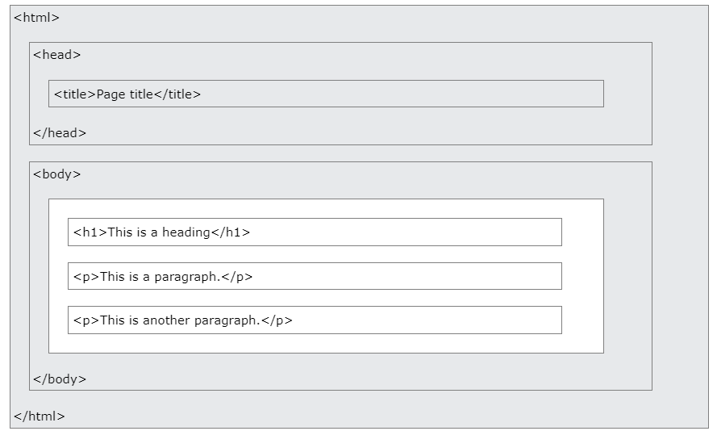
Note: The content inside the <body> section (the white area above) will be displayed in a browser. The content inside the <title> element will be shown in the browser's title bar or in the page's tab.

Slide 11
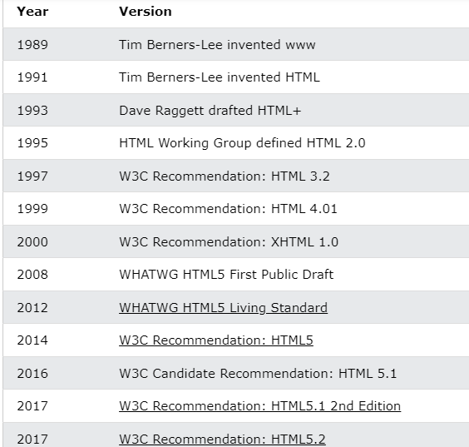

Slide 12
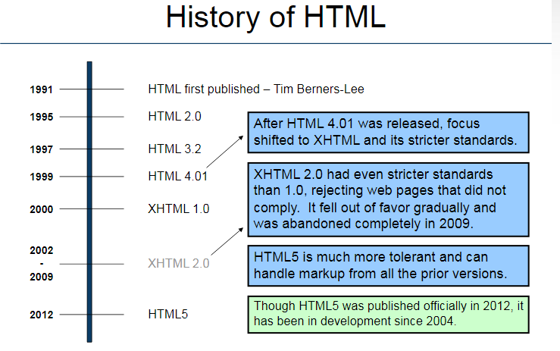

Slide 13
Learn HTML Using Notepad or TextEdit
Step 1: Open Notepad (PC)
Windows 8 or later:
Open the Start Screen (the window symbol at the bottom left on your screen). Type Notepad.
Windows 7 or earlier:
Open Start > Programs > Accessories > Notepad

Slide 14
Step 2: Write Some HTML
Write or copy the following HTML code into Notepad:
<!DOCTYPE html> <html> <body> <h1>My First Heading</h1> <p>My first paragraph.</p> </body> </html>

Slide 15
Step 3: Save the HTML Page
Save the file on your computer. Select File > Save as in the Notepad menu.
Name the file "index.htm" and set the encoding to UTF-8 (which is the preferred encoding for HTML files).

Slide 16
Step 4: View the HTML Page in Your Browser
Open the saved HTML file in your favorite browser (double click on the file, or right-click - and choose "Open with").
The result will look much like this:

Slide 17
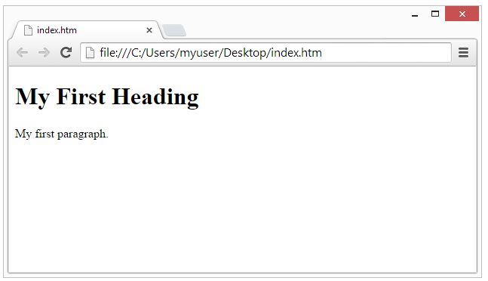

Slide 18
HTML Basic Examples
HTML Documents
All HTML documents must start with a document type declaration: <!DOCTYPE html>.
The HTML document itself begins with <html> and ends with </html>.
The visible part of the HTML document is between <body> and </body>.

Slide 19
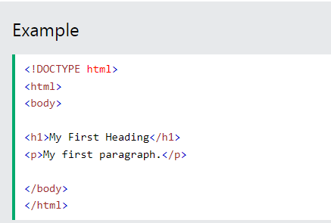

Slide 20
The <!DOCTYPE> Declaration
The <!DOCTYPE> declaration represents the document type, and helps browsers to display web pages correctly.
It must only appear once, at the top of the page (before any HTML tags).
The <!DOCTYPE> declaration is not case sensitive.
The <!DOCTYPE> declaration for HTML5 is:
<!DOCTYPE html>

Slide 21
HTML Headings
HTML headings are defined with the <h1> to <h6> tags.
<h1> defines the most important heading. <h6> defines the least important heading:
<h1>This is heading 1</h1> <h2>This is heading 2</h2> <h3>This is heading 3</h3>

Slide 22
HTML Paragraphs
HTML paragraphs are defined with the <p> tag:
<p>This is a paragraph.</p> <p>This is another paragraph.</p>
HTML Links
HTML links are defined with the <a> tag:
<a href="https://www.w3schools.com">This is a link</a>

Slide 23
The link's destination is specified in the href attribute.
Attributes are used to provide additional information about HTML elements.
You will learn more about attributes in a later chapter.

Slide 24
HTML Images
HTML images are defined with the <img> tag.
The source file (src), alternative text (alt), width, and height are provided as attributes:
<img src=“sjce.jpg" alt=“sjce.ac.in" width="104" height="142">

Slide 25
How to View HTML Source
View HTML Source Code:
Right-click in an HTML page and select "View Page Source" (in Chrome) or "View Source" (in Edge), or similar in other browsers. This will open a window containing the HTML source code of the page.
Inspect an HTML Element:
Right-click on an element (or a blank area), and choose "Inspect" or "Inspect Element" to see what elements are made up of (you will see both the HTML and the CSS). You can also edit the HTML or CSS on-the-fly in the Elements or Styles panel that opens.

Slide 26
HTML Elements
An HTML element is defined by a start tag, some content, and an end tag.
HTML Elements
The HTML element is everything from the start tag to the end tag:
<tagname>Content goes here...</tagname>
Examples of some HTML elements:
<h1>My First Heading</h1>
<p>My first paragraph.</p>
Note: Some HTML elements have no content (like the <br> element). These elements are called empty elements. Empty elements do not have an end tag!

Slide 27
Nested HTML Elements
HTML elements can be nested (this means that elements can contain other elements).
All HTML documents consist of nested HTML elements.
The following example contains four HTML elements (<html>, <body>, <h1> and <p>):

Slide 28
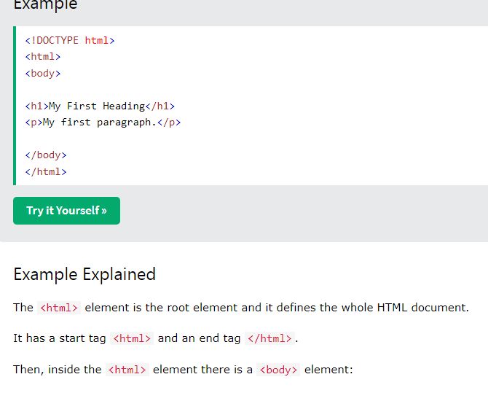

Slide 29
The <body> element defines the document's body.
It has a start tag <body> and an end tag </body>.
Then, inside the <body> element there are two other elements: <h1> and <p>:
<h1>My First Heading</h1> <p>My first paragraph.</p>

Slide 30
<body> <h1>My First Heading</h1> <p>My first paragraph.</p> </body>

Slide 31
Empty HTML Elements
HTML elements with no content are called empty elements.
The <br> tag defines a line break, and is an empty element without a closing tag:
<p>This is a <br> paragraph with a line break.</p>

Slide 32
HTML is Not Case Sensitive
HTML tags are not case sensitive: <P> means the same as <p>.

Slide 33
HTML Attributes
HTML attributes provide additional information about HTML elements.
HTML Attributes
All HTML elements can have attributes
Attributes provide additional information about elements
Attributes are always specified in the start tag
Attributes usually come in name/value pairs like: name="value"

Slide 34
The href Attribute
The <a> tag defines a hyperlink. The href attribute specifies the URL of the page the link goes to:
<a href="https://SJCE.AC.IN">Visit SJCE</a>

Slide 35
The src Attribute
The <img> tag is used to embed an image in an HTML page. The src attribute specifies the path to the image to be displayed:
<img src="img_sjce.jpg">

Slide 36
There are two ways to specify the URL in the src attribute:
1. Absolute URL - Links to an external image that is hosted on another website. Example: src="https://www.w3schools.com/images/img_girl.jpg".
Notes: External images might be under copyright. If you do not get permission to use it, you may be in violation of copyright laws. In addition, you cannot control external images; it can suddenly be removed or changed.
2. Relative URL - Links to an image that is hosted within the website. Here, the URL does not include the domain name. If the URL begins without a slash, it will be relative to the current page. Example: src="img_girl.jpg". If the URL begins with a slash, it will be relative to the domain. Example: src="/images/img_girl.jpg".
Tip: It is almost always best to use relative URLs. They will not break if you change domain.

Slide 37
The width and height Attributes
The <img> tag should also contain the width and height attributes, which specify the width and height of the image (in pixels):
<img src="img_sjce.jpg" width="500" height="600">

Slide 38
The alt Attribute
The required alt attribute for the <img> tag specifies an alternate text for an image, if the image for some reason cannot be displayed. This can be due to a slow connection, or an error in the src attribute, or if the user uses a screen reader.
<img src="img_sjce.jpg" alt=“sjce campus">

Slide 39
<!DOCTYPE html>
<html>
<body>
<img src="img_typo.jpg" alt=“sjce campus">
<p>If we try to display an image that does not exist, the value of the alt attribute will be displayed instead. </p>
</body>
</html>

Slide 40
he style Attribute
The style attribute is used to add styles to an element, such as color, font, size, and more.
<!DOCTYPE html>
<html>
<body>
<h2>The style Attribute</h2>
<p>The style attribute is used to add styles to an element, such as color:</p>
<p style="color:red;">This is a red paragraph.</p>
</body>
</html>

Slide 41
The lang Attribute
You should always include the lang attribute inside the <html> tag, to declare the language of the Web page. This is meant to assist search engines and browsers.
The following example specifies English as the language:

Slide 42
Country codes can also be added to the language code in the lang attribute. So, the first two characters define the language of the HTML page, and the last two characters define the country.
The following example specifies English as the language and United States as the country:
<!DOCTYPE html> <html lang="en-US"> <body> ... </body> </html>

Slide 43
The title Attribute
The title attribute defines some extra information about an element.
The value of the title attribute will be displayed as a tooltip when you mouse over the element:

Slide 44
<!DOCTYPE html>
<html>
<body>
<h2 title="I'm a header">The title Attribute</h2>
<p title="I'm a tooltip">Mouse over this paragraph, to display the title attribute as a tooltip.</p>
</body>
</html>

Slide 45
<!DOCTYPE html>
<html>
<body>
<h2>Single or Double Quotes?</h2>
<p>In some situations, when the attribute value itself contains double quotes, it is necessary to use single quotes:</p>
<p>Move your mouse over the paragraphs below to see the effect:</p>
<p title='John "ShotGun" Nelson'>John with double quotes</p>
<p title="John 'ShotGun' Nelson">John with single quotes</p>
</body>
</html>

Slide 46
Chapter Summary
All HTML elements can have attributes
The href attribute of <a> specifies the URL of the page the link goes to
The src attribute of <img> specifies the path to the image to be displayed
The width and height attributes of <img> provide size information for images
The alt attribute of <img> provides an alternate text for an image
The style attribute is used to add styles to an element, such as color, font, size, and more
The lang attribute of the <html> tag declares the language of the Web page
The title attribute defines some extra information about an element

Slide 47
HTML Headings
HTML headings are titles or subtitles that you want to display on a webpage.
<!DOCTYPE html>
<html>
<body>
<h1>Heading 1</h1>
<h2>Heading 2</h2>
<h3>Heading 3</h3>
<h4>Heading 4</h4>
<h5>Heading 5</h5>
<h6>Heading 6</h6>
</body>
</html>

Slide 48
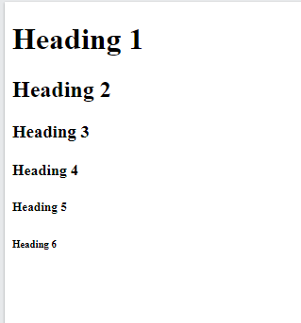

Slide 49
HTML Headings
HTML headings are defined with the <h1> to <h6> tags.
<h1> defines the most important heading. <h6> defines the least important heading.

Slide 50
<!DOCTYPE html>
<html>
<body>
<h1>Heading 1</h1>
<h2>Heading 2</h2>
<h3>Heading 3</h3>
<h4>Heading 4</h4>
<h5>Heading 5</h5>
<h6>Heading 6</h6>
</body>
</html>

Slide 51
Headings Are Important
Search engines use the headings to index the structure and content of your web pages.
Users often skim a page by its headings. It is important to use headings to show the document structure.
<h1> headings should be used for main headings, followed by <h2> headings, then the less important <h3>, and so on.
Note: Use HTML headings for headings only. Don't use headings to make text BIG or bold.

Slide 52
Bigger Headings
Each HTML heading has a default size. However, you can specify the size for any heading with the style attribute, using the CSS font-size property:

Slide 53
!DOCTYPE html>
<html>
<body>
<h1 style="font-size:60px;">Heading 1</h1>
<p>You can change the size of a heading with the style attribute, using the font-size property.</p>
</body>
</html>

Slide 54
se the correct HTML tag to add a heading with the text "London".
______________ <p>London is the capital city of England. It is the most populous city in the United Kingdom, with a metropolitan area of over 13 million inhabitants.</p>

Slide 55
HTML Paragraphs
A paragraph always starts on a new line, and is usually a block of text.
HTML Paragraphs
The HTML <p> element defines a paragraph.
A paragraph always starts on a new line, and browsers automatically add some white space (a margin) before and after a paragraph.

Slide 56
<!DOCTYPE html>
<html>
<body>
<p>This is a paragraph.</p>
<p>This is a paragraph.</p>
<p>This is a paragraph.</p>
</body>
</html>

Slide 57
HTML Display
You cannot be sure how HTML will be displayed.
Large or small screens, and resized windows will create different results.
With HTML, you cannot change the display by adding extra spaces or extra lines in your HTML code.
The browser will automatically remove any extra spaces and lines when the page is displayed:

Slide 58
<!DOCTYPE html>
<html>
<body>
<p>
This paragraph
contains a lot of lines
in the source code,
but the browser
ignores it.
</p>
<p>
This paragraph
contains a lot of spaces
in the source code,
but the browser
ignores it.
</p>
<p>
The number of lines in a paragraph depends on the size of the browser window. If you resize the browser window, the number of lines in this paragraph will change.
</p>
</body>
</html>

Slide 59
O/P
This paragraph contains a lot of lines in the source code, but the browser ignores it.
This paragraph contains a lot of spaces in the source code, but the browser ignores it.
The number of lines in a paragraph depends on the size of the browser window. If you resize the browser window, the number of lines in this paragraph will change.

Slide 60
HTML Horizontal Rules
The <hr> tag defines a thematic break in an HTML page, and is most often displayed as a horizontal rule.
The <hr> element is used to separate content (or define a change) in an HTML page:

Slide 61
<!DOCTYPE html>
<html>
<body>
<h1>This is heading 1</h1>
<p>This is some text.</p>
<hr>
<h2>This is heading 2</h2>
<p>This is some other text.</p>
<hr>
<h2>This is heading 2</h2>
<p>This is some other text.</p>
</body>
</html>
NOTE:The <hr> tag is an empty tag, which means that it has no end tag.

Slide 62
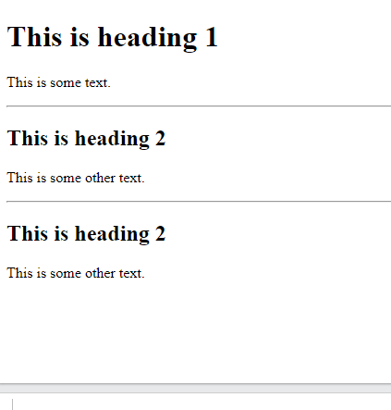
O/P

Slide 63
HTML Line Breaks
The HTML <br> element defines a line break.
Use <br> if you want a line break (a new line) without starting a new paragraph:

Slide 64
<!DOCTYPE html>
<html>
<body>
<p>This is<br>a paragraph<br>with line breaks.</p>
</body>
</html>

Slide 65
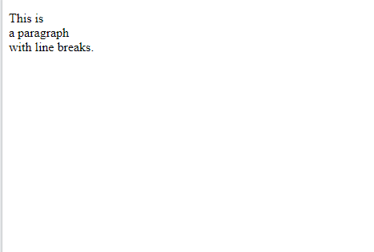
O/P

Slide 66
The Poem Problem
This poem will display on a single line:
<p> My Bonnie lies over the ocean. My Bonnie lies over the sea. My Bonnie lies over the ocean. Oh, bring back my Bonnie to me. </p>

Slide 67
<!DOCTYPE html>
<html>
<body>
<p>In HTML, spaces and new lines are ignored:</p>
<p>
My Bonnie lies over the ocean.
My Bonnie lies over the sea.
My Bonnie lies over the ocean.
Oh, bring back my Bonnie to me.
</p>
</body>
</html>

Slide 68
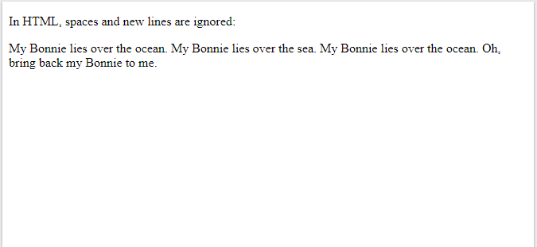
O/P

Slide 69
Solution - The HTML <pre> Element
The HTML <pre> element defines preformatted text.
The text inside a <pre> element is displayed in a fixed-width font (usually Courier), and it preserves both spaces and line breaks:

Slide 70
Solution - The HTML <pre> Element
The HTML <pre> element defines preformatted text.
The text inside a <pre> element is displayed in a fixed-width font (usually Courier), and it preserves both spaces and line breaks:

Slide 71
<!DOCTYPE html>
<html>
<body>
<p>The pre tag preserves both spaces and line breaks:</p>
<pre>
My Bonnie lies over the ocean.
My Bonnie lies over the sea.
My Bonnie lies over the ocean.
Oh, bring back my Bonnie to me.
</pre>
</body>
</html>

Slide 72
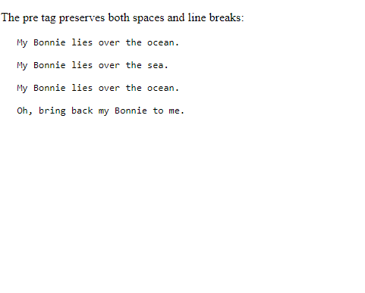
O/P

Slide 73
Exercise:
Use the correct HTML tag to add a paragraph with the text "Hello World!".
<html> <body> </body> </html>

